Slide 1
Partner Marketing:
Program Value Propositions
Jan 2023

Slide 2
Product Experience - Messaging Guidelines

Slide 3
The New Car flow provides pricing context and an upfront offer on nationwide inventory to enhance and fast-track the purchase experience
Price Transparency
Long form -
Identify a fair price. Use our pricing graph to learn what others in your area paid for the car you want.
Get a comprehensive price for the vehicle you want that includes manufacturer incentives and dealer discounts.
Short form -
See what others paid for the vehicle you want.
Upfront Pricing
Long form -
At TrueCar, you can get a personalized offer on an in-stock vehicle that closely matches the car you configured.
When you submit your contact details, you’ll get upfront, personalized offers on in-stock vehicles matching your preferences.
Short form -
You get real pricing on actual cars and trucks.
Get an upfront price from a dealer online, so you know what to pay before visiting.
Receive instant, competitive price offers from TrueCar Certified Dealers.
Transactional data
Long form -
TrueCar analyzes millions of transactions to provide shoppers with contextual pricing, so they can see what others in their area paid for the car they want.
TrueCar calculates the Market Average for the vehicle you want by analyzing recent sales transactions at the local, state, regional, or national level.
Short form -
TrueCar takes data and turns it into useful information.

Slide 4
The New Car flow provides pricing context and an upfront offer on nationwide inventory to enhance and fast-track the purchase experience
Get matched to real inventory
We help you configure a vehicle, then enable you to connect with a TrueCar Certified Dealer.
We analyze pricing, dealer, and vehicle information to help you find the right vehicle for the right price at the right dealership
Incentives
TrueCar shows you nationwide incentives as well as incentives from specific manufacturers, so you can see all the options you have.
We compile both national incentives and members-only incentives for you.
Saved searches
We also show you all of the vehicles you’ve already checked out, so you can easily compare favorites. You can also save your search and get alerts on vehicles you’re interested in.
We help you make your dream car a reality: choose make, model, trim, and options, and we'll help you find vehicles that match your selections.

Slide 5
The Used Car flow allows shoppers to browse nationwide inventory leveraging best-in-class filtering capabilities, including price, vehicle type, condition and dealer type
Pricing context
TrueCar shows you a price rating for used cars, so you can see if you’re getting a good, great, or excellent price.
TrueCar looks at listings for similar used cars to determine price ratings, taking into account factors like mileage, location, and condition.
Price ratings
Used car price ratings take into consideration mileage, location, options, and condition.
Based on pricing data for similar pre-owned cars, TrueCar determines the average list price for a car like the one you want, and then gives the car a price rating, so you can see whether you’re getting a good deal.
Price alerts
You can use TrueCar to set up alerts, so you know if there is a price change on your dream car.
Accessible information
Use TrueCar to find your perfect used car – you can filter by vehicle feature, mileage, price, and color, and even narrow your search to Certified Pre-Owned vehicles only.
Confidence
Get the best used car buying experience when you purchase from a TrueCar Certified Dealer who is dedicated to great service and saving you time and money.
TrueCar gives you detailed information about a vehicle’s history, condition, number of owners, and accidents.

Slide 6
Stages of the Car Buying Journey

Slide 7
Awareness
Research
Research and development tools empower buyers to identify the right car with confidence
Read reviews, view rankings and explore our shopping guides
Shop popular car, truck and SUV brands online
Get access to our over a 700k pre-owned vehicles for sales across the US
Compare
Find the new or used vehicle that is right for your lifestyle
Compare trims, photos, and reviews for every make and model
Compare price offers from local Certified Dealers
Convenience
Shop, compare and save from the comfort of your home

Slide 8
Consideration / Evaluation
Price Transparency
See what others paid - Tell us what you're looking for and we share what your neighbors paid.
Build the car you want. Know what others paid for it.
View detailed pricing data from sales of similar cars, so you can recognize a great price
Personalized Offers
Get real pricing on actual inventory before visiting the dealership
Compare competitive price offers from local Certified Dealers
Monthly Payments
Consider all your options and compare monthly payments between different models and makes

Slide 9
TrueCar Value Prop Study

Slide 10
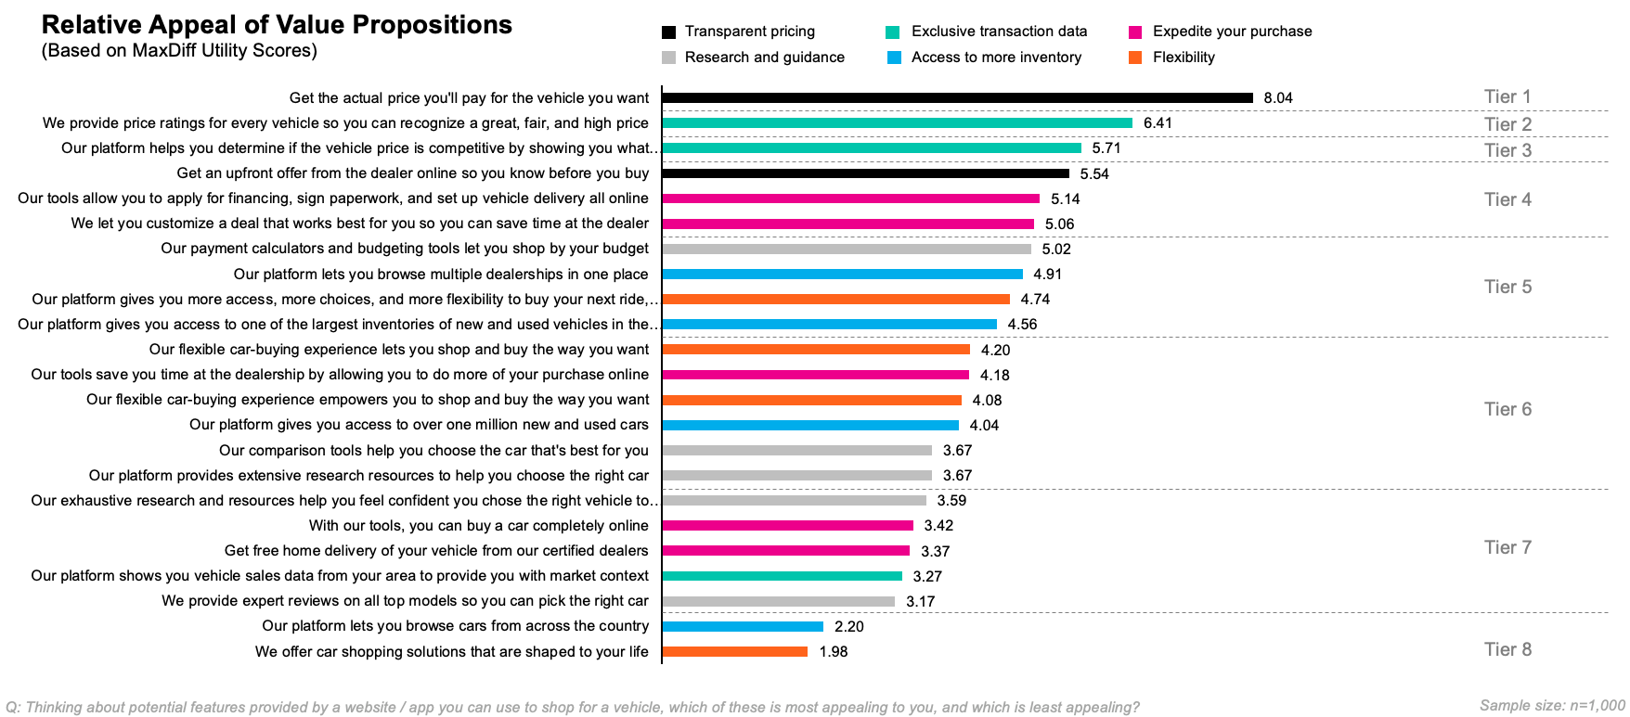
Value Prop Testing Results
Source: 2022 TrueCar Value Prop Testing

Slide 11
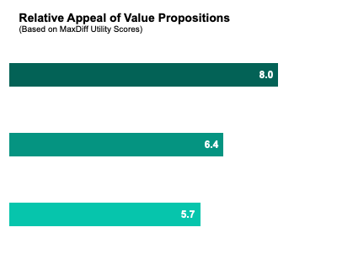
Pricing related value props round out the top three tiers. Get the actual price is the most appealing value prop by a notable margin, aligning with findings from prior studies.
Get the actual price you'll pay for the vehicle you want |  | Tier 1
We provide price ratings for every vehicle so you can recognize a great, fair, and high price |  | Tier 2
Our platform helps you determine if the vehicle price is competitive by showing you what others actually paid |  | Tier 3

Slide 12
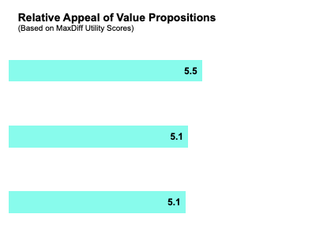
Tier 4 value props focus largely on the deal – i.e., upfront offer, deal customization, and ability to complete online.
Get an upfront offer from the dealer online so you know before you buy |  | Tier 4
Our tools allow you to apply for financing, sign paperwork, and set up vehicle delivery all online |  | Tier 4
We let you customize a deal that works best for you so you can save time at the dealer |  | Tier 4

Slide 13
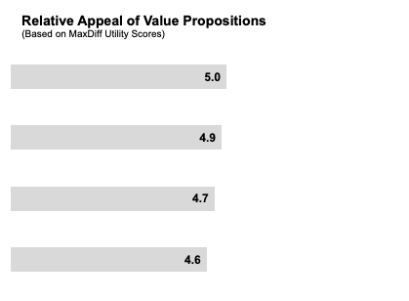
Tier 5 value props revolve around the shopping experience – i.e., the ability to shop by budget, browse multiple dealers, and access extensive inventory.
Our payment calculators and budgeting tools let you shop by your budget |  | Tier 5
Our platform lets you browse multiple dealerships in one place |  | Tier 5
Our platform gives you more access, more choices, and more flexibility to buy your next ride, your way |  | Tier 5
Our platform gives you access to one of the largest inventories of new and used vehicles in the country |  | Tier 5

Slide 14
Headline Copy Examples

Slide 15
Example Headlines
Feel free to Plug & Play this copy into your marketing.
Find and finance your next car with [Partner Name] Car Buying Service.
Shop new and used cars online
View upfront price offers on local vehicle inventory
Search and compare vehicles from top brands
Finance your next vehicle with [Partner Name] Car Buying Service
Find your next ride
Shop top car brands
Member Car Buying
See what others paid for the car you want
View upfront pricing on cars and trucks

